Slide 1
SEMICONDUCTOR FUNDAMENTALS

Slide 2
Commonly used forms in electronics
Diodes
Transistors
Integrated Circuits
And many others

Slide 3
Advantages of Semiconductors
Small size and weight
Low power consumption
High efficiency
Great reliability
Instant operation when power is applied
Economic mass production

Slide 4
Disadvantages of Semiconductors
Great susceptibility to change in temperature
Extra components required for stabilization
Easily damaged by heat when soldering into a circuit

Slide 5
Semiconduction in Germanium and Silicon
Semiconductor materials
Possess characteristics that fall between those of insulators and conductors
Pure semiconductor elements
Carbon (C)
Germanium (Ge)
Silicon (Si)
Used for most semiconductor devices

Slide 6
Germanium
A powder of Germanium dioxide is recovered from ashes of certain coals and then reduced to solid form of Germanium

Slide 7
Silicon
Found extensively in earth’s crust in silicon diode.
Found abundantly in sand, quartz, agate in form of silicon dioxide (silica) and chemically reduced to pure silicon.

Slide 8
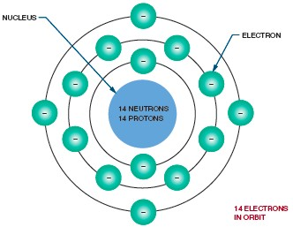
Semiconduction in Germanium and Silicon (cont’d.)
Figure 19-1. Atomic structure of silicon.

Slide 9
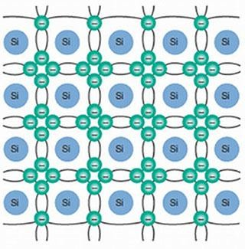
Figure 19-3. Crystalline structure of silicon with covalent bonding.

Slide 10
The covalent bond cannot support electrical activity because of its stability
At room temperature , pure silicon crystals are poor conductors and behave like insulators
After heat applied and temperature increased

Slide 11
Semiconduction in Germanium and Silicon (cont’d.)
Negative temperature coefficient
As temperature increases, resistance decreases
Heat
Potential source of trouble for semiconductors
Electrons break their covalent bonds

Slide 12
Effect of temperature on Ge
Ge in heat sensitive devices

Slide 13
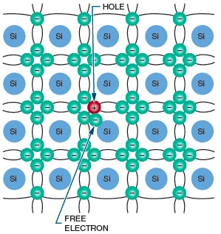
Figure 19-4. A hole is created when an electron breaks its covalent bond.

Slide 14
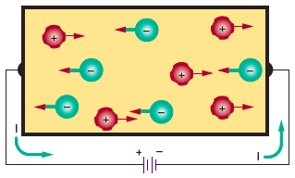
Conduction in Pure Germanium and Silicon (cont’d.)
Figure 19-5. Current flow in pure semiconductor material.

Slide 15
Conduction in Doped Germanium and Silicon
Doping
Adding impurities to a semiconductor material
Pentavalent
Made of atoms with five valence electrons
Trivalent
Made of atoms with three valence electrons

Slide 16
Conduction in Doped Germanium and Silicon (cont’d.)
N-type material
Pentavalent materials
Electrons are the majority carrier
Holes are the minority carrier
Donor atoms

Slide 17
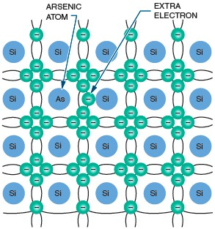
Figure 19-6. Silicon semiconductor material doped with an arsenic atom.

Slide 18
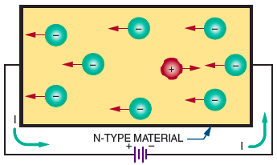
Conduction in Doped Germanium and Silicon (cont’d.)
Figure 19-7. Current flow in N-type material.

Slide 19
Conduction in Doped Germanium and Silicon (cont’d.)
P-type material
Trivalent materials
Holes are the majority carrier
Electrons are the minority carrier
Acceptor atoms

Slide 20
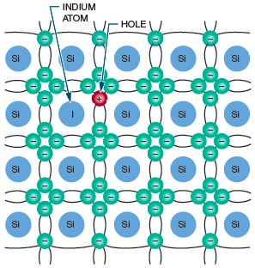
Figure 19-8. Silicon semiconductor material doped with an indium atom.

Slide 21
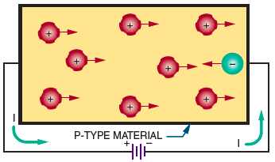
Conduction in Doped Germanium and Silicon (cont’d.)
Figure 19-9. Current flow in P-type material.

